Slide 1
Machine Learning Lifecycle
Pravin Y Pawar
Adapted from AWS Well-Architected machine learning

Slide 2
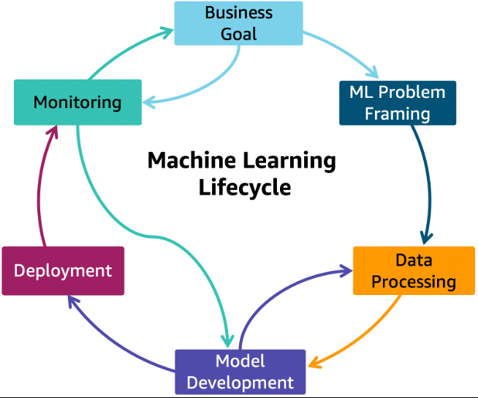
Machine Learning Lifecycle
Cyclic iterative process with instructions, and best practices to use across defined phases while developing an ML workload
adds clarity and structure for making a machine learning project successful
The end-to-end machine learning lifecycle process includes the following phases:
Business goal identification
ML problem framing
Data processing (data collection, data preprocessing, feature engineering)
Model development (training, tuning, evaluation)
Model deployment (inference, prediction)
Model monitoring
The phases of the ML lifecycle are not necessarily sequential in nature and can have feedback loops
to interrupt the cycle across the lifecycle phases

Slide 3
Machine Learning Lifecycle(2)
Phases
Business goal
should have a clear idea of the problem, and the business value to be gained by solving that problem
must be able to measure business value against specific business objectives and success criteria
ML problem framing
the business problem is framed as a machine learning problem
what is observed and what should be predicted (known as a label or target variable)
Determining what to predict and how performance and error metrics must be optimized is a key step in this phase
Data processing
Training an accurate ML model requires data processing to convert data into a usable format
includes collecting data, preparing data
and feature engineering that is the process of creating, transforming, extracting, and selecting variables from data
Model development
consists of model building, training, tuning, and evaluation
includes creating a CI/CD pipeline that automates the build, train and release to staging and production environments
Deployment
After a model is trained, tuned, evaluated and validated, one can deploy the model into production
can then make predictions and inferences against the model
Monitoring
ensures model is maintaining a desired level of performance through early detection and mitigation

Slide 4
ML lifecycle phase — Business goal
The most important phase particularly challenging when considering ML solutions because ML is a constantly evolving technology!
After success criteria is defined, evaluate organization's ability to move toward that target
The target should be achievable and provide a clear path to production
Involve
all relevant stakeholders from the beginning to align them to this target
any new business processes that will result from this initiative
Steps in this phase:
Understand business requirements
Form a business question
Review a project’s ML feasibility and data requirements
Evaluate the cost of data acquisition, training, inference, and wrong predictions
Review proven or published work in similar domains, if available
Determine key performance metrics, including acceptable errors
Deﬁne the machine learning task based on the business question
Identify critical, must have features
Design small, focused POCs to validate all of the preceding
Evaluate if bringing in external data sources will improve model performance
Establish pathways to production
Consider new business processes that may come out of this implementation
Align relevant stakeholders with this initiative

Slide 5
ML lifecycle phase — ML problem framing
Business problem is framed as a machine learning problem
what is observed and what should be predicted (known as a label or target variable)
Determining what to predict and how performance must be optimized is a key step in ML
Steps in this phase:
Deﬁne criteria for a successful outcome of the project
Establish an observable and quantiﬁable performance metric for the project, such as accuracy
Help ensure business stakeholders understand and agree with the defined performance metrics
Formulate the ML question in terms of inputs, desired outputs, and the performance metric to be optimized
Evaluate whether ML is the right approach
Some business problems don’t need ML, simple business rules can do a much better job
For other business problems, there might not be sufficient data to apply ML as a solution
Create a strategy to achieve the data sourcing and data annotation objective
Start with a simple model that is easy to interpret, and which makes debugging more manageable

Slide 6
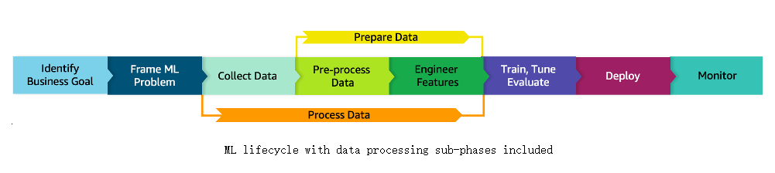
ML lifecycle architecture diagram
ML lifecycle with data processing sub-phases included

Slide 7
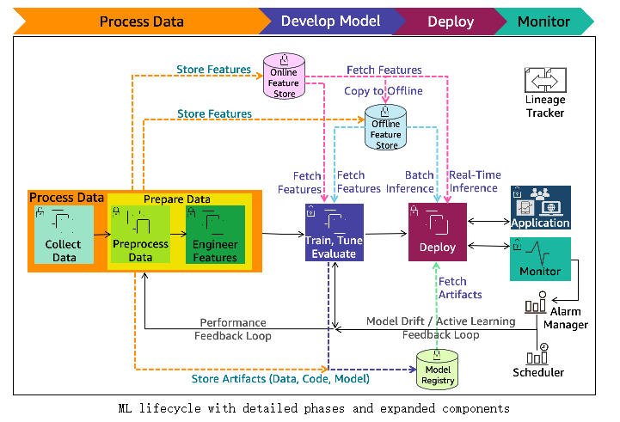
ML lifecycle architecture diagram(2)
ML lifecycle with detailed phases and expanded components

Slide 8
ML lifecycle architecture diagram(3)
Components
Online/Offline feature store
reduces duplication and rerun of feature engineering code across teams and projects
Online store with low-latency retrieval capabilities is ideal for real-time inference
Offline store should maintain a history of feature values and is suited for training and batch scoring
Model registry
A repository for storing ML model artifacts including trained model and related metadata (data, code, model)
enables lineage for ML models as it can act as a version control system
Performance feedback loop
Automates model performance evaluation tasks initiated from the model development to data processing phase
Model drift feedback loop
Automates model update re-training tasks initiated from the production deployment to data processing phase

Slide 9
ML lifecycle architecture diagram(4)
Components
Alarm manager
receives the alerts from the model monitoring system
runs actions by publishing notifications to services that can deliver alerts to target applications to handle them
The model update re-training pipeline is one such target application
Scheduler
A scheduler can initiate a re-training at business defined intervals
Lineage tracker
enables reproducible machine learning experiences
enables re-creating the ML environment at a specific point-in-time, reflecting the versions of all resources and environments at that time
collects references to traceable data, model and infrastructure resource changes

Slide 10
ML lifecycle phase - Data processing
Need
In ML workloads, the data (inputs and corresponding desired output) serves important functions including:
Deﬁning the goal of the system: the output representation and the relationship of each output to each input, by means of input/output pairs
Training the algorithm that associates inputs to outputs
Measuring the performance of the trained model, and evaluating whether the performance target was met
Building baselines to monitor the performance of the models deployed to production
Data processing includes data collection and data preparation
Data preparation includes data preprocessing and feature engineering
Data wrangling is data preparation during the interactive data analysis and model development
Data Visualization can help with exploratory data analysis (EDA)
EDA can help with understanding data, sanity checks, and validating the quality of the data
The same sequence of data processing steps that you apply to the training data is also applied to the inference requests.

Slide 11
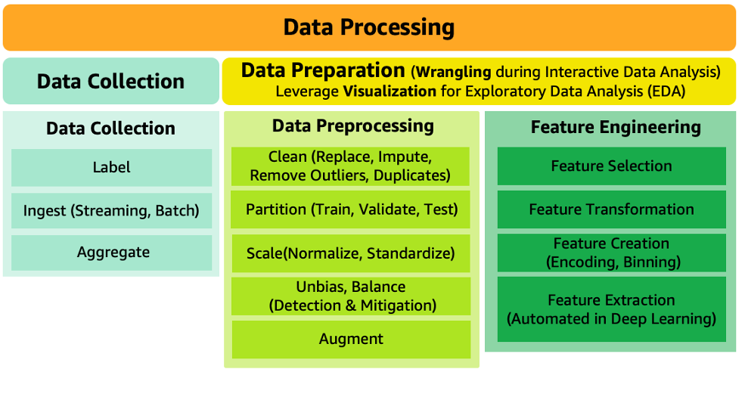
ML lifecycle phase - Data processing(2)
Data processing components

Slide 12
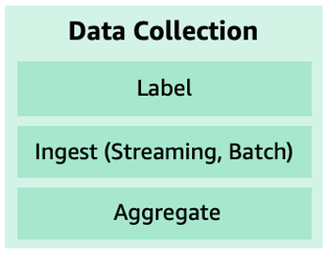
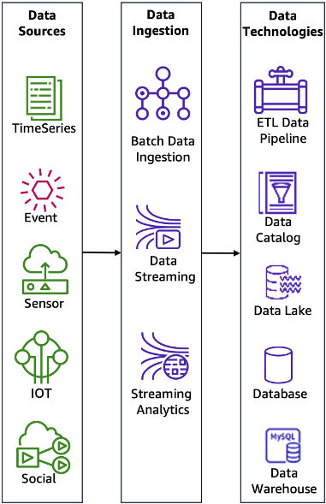
ML lifecycle phase - Data processing(3)
Data collection
One of the first steps in the ML lifecycle is to identify what data is needed
Then evaluate the various means available for collecting that data to train model
Activities in the data collection phase:
Label — Data for which already know the target answer is called labeled data
If labels are missing, then some effort is required to label it (manual or automated)
Ingest & Aggregate
Data collection includes ingesting and aggregating data from multiple data sources
Some components of the ingest and aggregate:
Data sources
include time-series, events, sensors, IoT devices, and social networks, depending on the nature of the use case
Data ingestion
processes and technologies capture and store data on storage media
can occur in real-time using streaming technologies or historical mode using batch technologies
Data technologies
Data storage technologies vary from transactional (SQL) databases, to data lakes and data warehouses
ETL pipeline technology automates and orchestrates the data movement and transformations across cloud services and resources
A data lake technology enables storing and analyzing structured and unstructured data

Slide 13
ML lifecycle phase - Data processing(4)
Data preparation
ML models are only as good as the data that is used to train them
Ensure that suitable training data is available and is optimized for learning and generalization
Data preparation includes
data preprocessing
feature engineering
A key aspect to understanding data is to identify patterns which are often not evident with data in tables
Exploratory data analysis (EDA) with visualization tools can help quickly gain a deeper understanding of data
Prepare data using wrangler tools for interactive data analysis and model building
The no-code/low-code, automation, and visual capabilities improve the productivity and reduces the cost for interactive analysis

Slide 14
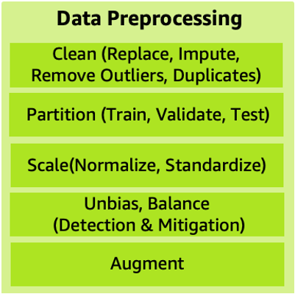
ML lifecycle phase - Data processing(5)
Data preprocessing
Data preprocessing puts data into the right shape and quality for training
Many strategies: data cleaning, balancing, replacing, imputing, partitioning, scaling, augmenting and unbiasing
Clean (replace, impute, remove outliers and duplicates)
Remove outliers and duplicates, replace inaccurate or irrelevant data
Correct missing data using imputation techniques that will minimize bias as part of data cleaning
Partition
To prevent ML models from overfitting and evaluate trained model accurately, randomly split data into train, validate, and test sets
Care is needed to avoid data leakage
Data leakage happens when information from hold-out test dataset leaks into the training data
One way to avoid data leakage is to remove duplicates before splitting of the data

Slide 15
ML lifecycle phase - Data processing(6)
Data preprocessing
Scale (normalize, standardize)
Having features on a similar scale close to normally distributed will ensure that each feature is equally important
make it easier for most ML algorithms including K-Means, KNN, PCA, gradient descent
Standardization better handles the outliers
Unbias, balance (detection & mitigation)
Detecting and mitigating bias will help avoiding inaccurate model results
Biases are imbalances in the accuracy of predictions across different groups, such as age or income bracket
Biases can come from the data or algorithm used to train your model
Augment
increases the amount of data artificially by synthesizing new data from existing data
can help regularize and reduce overfitting

Slide 16
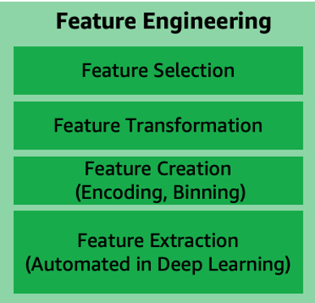
ML lifecycle phase - Data processing(7)
Feature engineering
Every unique attribute of the data is considered a feature
Feature engineering is a process to select and transform variables when creating a predictive model using machine learning or statistical modeling
includes feature creation, feature transformation, feature extraction, and feature selection
With deep learning, the feature engineering is automated as part of the algorithm learning
Feature creation
is creating new features from existing data to help with better predictions
Examples of feature creation techniques include: one-hot-encoding, binning, splitting, and calculated features
Feature transformation and imputation
manage replacing missing features or features that are not valid
Some techniques include: forming Cartesian products of features, non-linear transformations (such as binning numeric variables into categories), and creating domain-speciﬁc features
Feature extraction
involves reducing the amount of data to be processed using dimensionality reduction techniques
reduces the amount of memory and computing power required, while still accurately maintaining original data characteristics
Techniques include: PCA, ICA, and LDA
Feature selection
process of selecting subset of extracted features which is relevant and contributes to minimizing the error rate of a trained model
Feature importance score and correlation matrix can be factors in selecting the most relevant features for model training

Slide 17
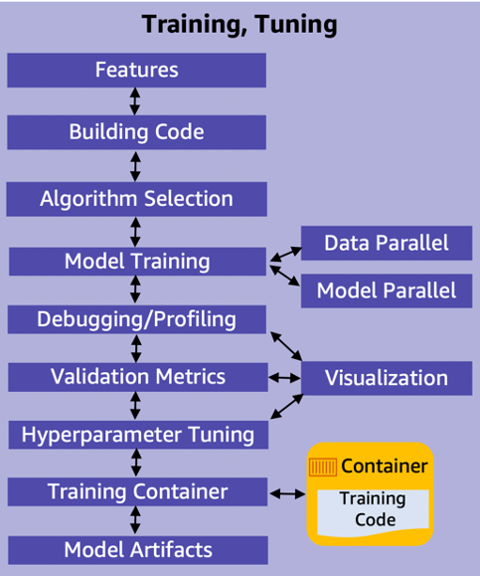
ML lifecycle phase – Model development
Model building, training, tuning
In this phase, select a machine learning algorithm that is appropriate for problem and then train the ML model
provide the algorithm with the training data
set an objective metric for the ML model to optimize on
and set the hyperparameters to optimize the training process

Slide 18
ML lifecycle phase – Model development(2)
Model training, tuning activities
Model training, tuning, and evaluation require prepared data and engineered features
Features selection
Features are selected as part of the data processing after a bias strategy is implemented
Building code
Model development includes building the algorithm and its supporting code
should support version control, and continuous build, test, and integration through a pipeline
Algorithm selection
Selecting the right algorithm involves running many experiments with parameter tunings across available options
Factors to consider when evaluating each option can include accuracy, explainability, training/prediction time, memory requirements
Model training (data training parallel, model training parallel)
The process of training an ML model involves providing an ML algorithm with training data to learn from
Distributed training enables splitting large models and training datasets across computing instances to reduce runtime to fraction of it takes to do manually
Model parallelism is the process of splitting a model up between multiple devices or nodes.
Data parallelism is the process of splitting the training set in mini-batches evenly distributed across nodes
each node only trains the model on a fraction of the total dataset

Slide 19
ML lifecycle phase – Model development(3)
Model training, tuning activities
Debugging/profiling
A machine learning training job can have problems including:
system bottlenecks, overfitting, saturated activation functions, and vanishing gradients. These problems can compromise model performance
A debugger provides visibility into the ML training process through monitoring, recording, and analyzing data
captures the state of a training job at periodic intervals
Validation metrics
Typically, a training algorithm computes several metrics, such as loss and prediction accuracy
determine if the model is learning and generalizing well for making predictions on unseen data
Metrics reported by the algorithm depend on the business problem and the ML technique used
Hyperparameter tuning
Settings that can be tuned to control the behavior of the ML algorithm are referred to as hyperparameters
The number and type of hyperparameters in ML algorithms are specific to each model
Examples of commonly used hyperparameters include: learning rate, number of epochs, hidden layers, hidden units, and activation functions
Hyperparameter tuning, or optimization, is the process of choosing the optimal hyperparameters for a learning algorithm
Training code container
Create container images with training code and its entire dependency stack
will enable training machine learning algorithms and deploy models quickly and reliably at any scale
Model artifacts
Model artifacts are the output that results from training a model
typically consist of trained parameters, a model definition that describes how to compute inferences, and other metadata.
Visualization
Enables exploring and understanding data during metrics validation, debugging, profiling, and hyperparameter tuning.

Slide 20
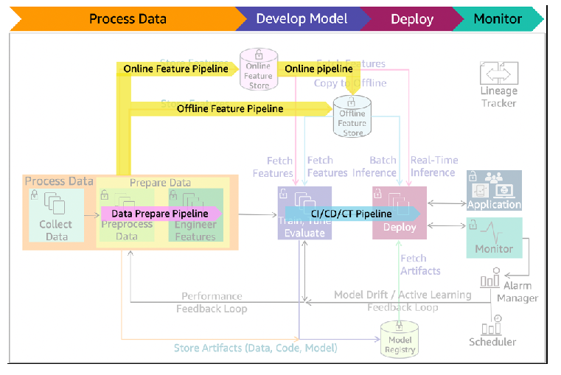
ML lifecycle phase – Model development(4)
ML lifecycle with pre-production pipelines
The data prepare pipeline automates data preparation tasks
The feature pipeline automates the storing, fetching, and copying of the features into and from online/offline store
The CI/CD/CT pipeline automates the build, train, and release to staging and production environments

Slide 21
ML lifecycle phase – Model development(5)
Model evaluation
After the model has been trained, evaluate it for its performance and accuracy
generate multiple models using different methods and evaluate the effectiveness of each model
for multiclass models, determine error rates for each class separately
Can evaluate model using historical data (offline evaluation) or live data (online evaluation)
Offline evaluation
the trained model is evaluated with a portion of the dataset that has been set aside as a holdout set
never used for model training or validation—it’s only used to evaluate errors in the final model
The holdout data annotations must have high accuracy for the evaluation to make sense
Allocate additional resources to verify the accuracy of the holdout data
Based on the evaluation results, might fine-tune the data, the algorithm, or both
may apply the concepts of data cleansing, preparation, and feature engineering again

Slide 22
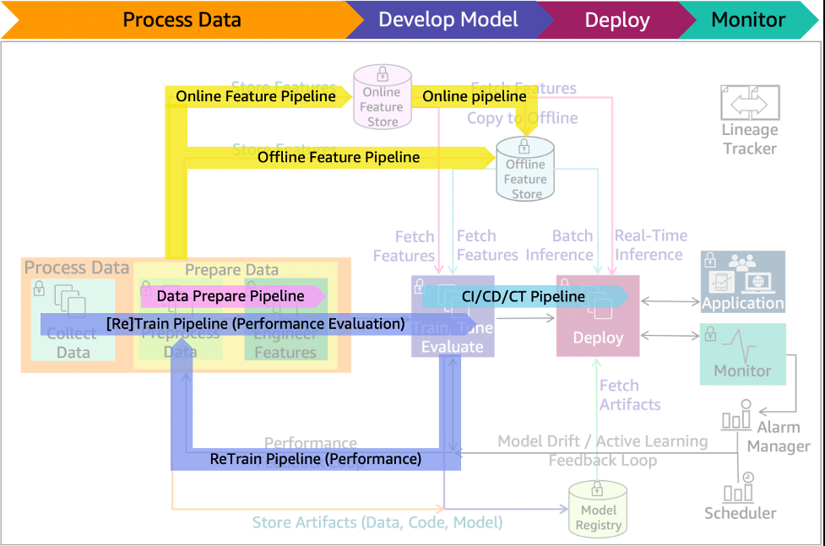
ML lifecycle phase – Model development(6)
ML lifecycle with performance evaluation pipeline added

Slide 23
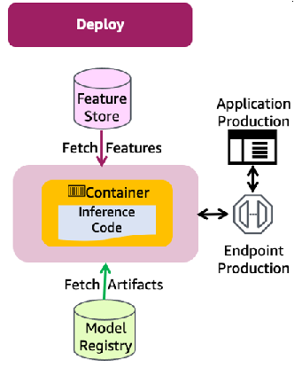
ML lifecycle phase - Deployment
After model have been trained, tuned, and evaluated, then can deploy the model into production
can make predictions and inferences against the deployed model
Use a manual governance process - ensures the model has fully been tested and evaluated before it’s released to production
Deploy production phase of the ML lifecycle
Features are retrieved from the feature store
Artifacts are taken from the model registry
Inference code used container from the container repository

Slide 24
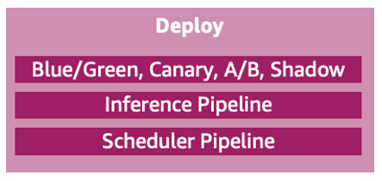
ML lifecycle phase – Deployment(2)
Deployment main components
Blue/green, canary, A/B, shadow deployment/testing
Deployment and testing strategies that reduce downtime and risks when releasing a new or updated version
The blue/green deployment technique
provides two identical production environments
can use this technique when need to deploy a new version of the model to production
Once testing is done on the green environment, live application traffic is directed to the green environment
Blue environment is maintained as backup
A canary deployment
first deploy the new release to a small group of users
Other users continue to use the previous version until satisfied with the new release
Then, can gradually roll the new release out to all users
A/B testing strategy
enables deploying changes to a model
Direct a deﬁned portion of traﬃc to the new model. Direct the remaining traﬃc to the old model
similar to canary testing, but has larger user groups and a longer time scale, typically days or even weeks
Shadow deployment strategy
New version is available alongside the old version
The input data is run through both versions
The older version is used for servicing the production and the new one is used for testing and analysis

Slide 25
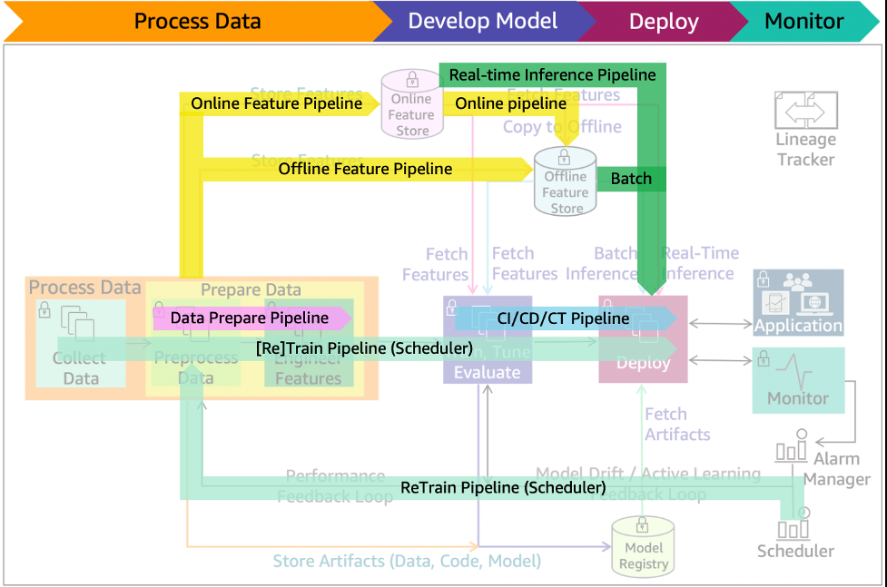
ML lifecycle phase – Deployment(3)
ML lifecycle with scheduler re-train, and batch/real-time Inference pipelines
Inference pipeline
automates capturing of the prepared data, performing predictions and post-processing for real-time or batch inferences
Scheduler pipeline
Deployed model is representative of the latest data patterns
Re-training at intervals can minimize the risk of data and concept drifts
A scheduler can initiate a re-training at business defined intervals
Data prepare, CI/CD/CT, and feature pipelines will also be active during this process

Slide 26
ML lifecycle phase – Monitoring
Post deployment monitor main components
The model monitoring system must
capture data,
compare that data to the training set, define rules to detect issues
and send alerts
Process repeats on a defined schedule, when initiated by an event, or when initiated by human intervention
The issues detected in the monitoring phase include: data quality, model quality, bias drift, and feature attribution drift
Key components of monitoring including:
Model explainability
uses explainability to evaluate the soundness of the model and if the predictions can be trusted
Detect drift
detects data and concept drifts
Data drift is the significant changes to data distribution compared to data used for training
Concept drift is when the properties of target variables change
Any kind of drift will result in model performance degradation
will initiate an alert and send it to alarm manager system
Model update pipeline
If alarm manager identifies any violations, it launches the model update pipeline for a re-train
Data prepare, CI/CD/CT, and feature pipelines will also be active during this process

Slide 27
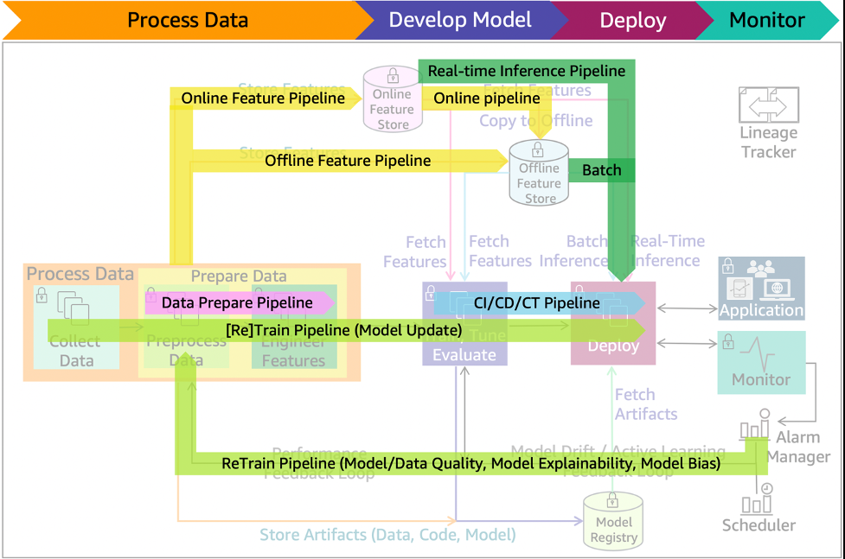
ML lifecycle phase – Monitoring(2)
ML lifecycle with model update re-train and batch/real-time Inference pipelines

Slide 28
Additional - Lineage tracker
Lineage tracker
Requirement
enables reproducible machine learning experiences
enables re-creating the ML environment at a specific point-in-time, reflecting the versions of all resources and environments at that time
collects references to traceable data, model and infrastructure resource changes
Components:
System architecture (infrastructure as code to address environment drift)
Data (metadata, values, and features)
Model (algorithm, features, parameters, and hyperparameters)
Code (implementation, modeling, and pipeline)
Working:
Collects changed references through alternative iterations of ML lifecycle phases
Alternative algorithms and feature lists are evaluated as experiments for final production deployment
The collected information enables going back to a specific point-in-time release and recreate it

Slide 29
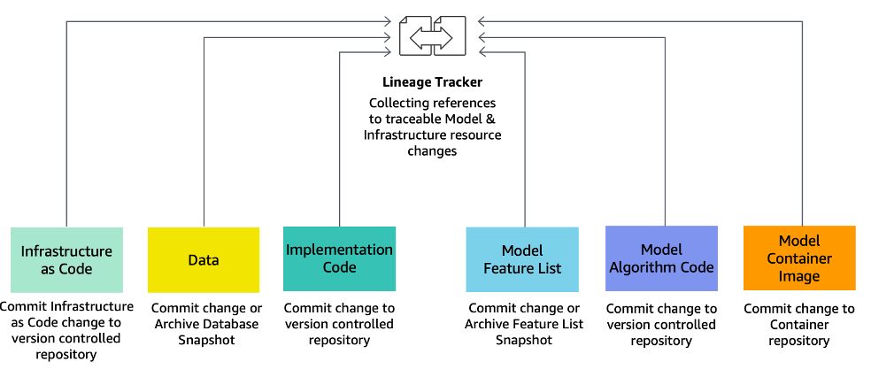
Lineage tracker

Slide 30
Lineage tracker
Components
Infrastructure as code (IaC)
Modeling, provisioning, and managing cloud computing resources (compute, storage, network, and application services) can be automated using IaC
eliminates configuration drift through automation, while increasing the speed and agility of infrastructure deployments
IaC code changes are committed to version-controlled repository
Data
Store data schemes and metadata in version control systems
Store the data in a storage media like a data lake
The location or link to the data can be in a configuration file and stored in code version control media
Implementation code
Changes to any implementation code at any point-in-time can be stored in version control media
Model feature list
Feature store technology referenced in the scenario architecture diagrams stores features as well as their versions for any point-in-time changes
Model algorithm code
Changes to any model algorithm code at any point-in-time can be stored in version control media
Model container image
Versions of model container images for any point-in-time changes can be stored in container repositories managed by container registry

Slide 31
Thank You!
In our next session:

